Slide 1

PROJECT DEFENSE
ON
DESIGN OPTIMIZATION OF MILITARY UNMANNED AERIAL VEHICLE RQ-20 PUMA
TO
DEPARTMENT OF AERONAUTICAL & ASTRONAUTICAL ENGINEERING
FACULTY OF ENGINEERING AND TECHNOLOGY
BY
GIWA ABDULWAHAB FUNSHO 16/67aa/075
Supervisor: Engr. Abdulbaqi Jinadu
September 2022

Slide 2
INTRODUCTION
Military Unmanned Aerial Vehicle (MAV) is an aircraft designed not to carry an aircrew for execution of its mission. It is widely use in military for aerial battle, reconnaissance and surveillance.
RQ-20 Puma is an all-environment, hand-launched reconnaissance and surveillance unmanned area vehicle. It provides operational capability in the following areas: Remote reconnaissance and surveillance, Force protection, Convoy security, Target acquisition and Battle damage assessment.

Slide 3
PROBLEM STATEMENT
It is observed that RQ-20 PUMA being belly a landing UAV, sustains substantial damage to its fuselage due to the absence of landing gear to protect the UAV fuselage during landing.

Slide 4
AIM AND OBJECTIVES
To optimize the design by integrating a fixed landing gear and design an unmanned aerial vehicle, RQ-20 PUMA to perform horizontal takeoff and landing on the runway to prevent the aircraft from belly landing and protect it from structural damage.
The UAV will be built to achieve the following criteria:
To design of the RQ-20 PUMA by integrating a fixed landing gear
Upgrading the UAV's takeoff mode
Increase the UAV's efficiency

Slide 5
SIGNIFICANCE OF PROJECT
The design optimization of the military UAV, RQ-20 puma is vital because it helps in preventing substantial damages of the UAV's structure and reduce the maintenance costs.

Slide 6
LITERATURE REVIEW
Title/Year | Author(S) | Summary of Result
Design, fabrication and performance analysis of UAV (2016) | M.I. Khan, M.A. Salam, & T. Mahmud | The conceptual design of UAV process goes step by step which gives brief over view of how the industry works in designing the UAV with requirement captured.
Design, manufacturing, and flight testing of an experimental flying wing UAV (2019) | Pei-Hsiang Chung, Der-Ming Ma, Jaw-Kuen Shiau | The design, manufacturing, and flight testing of an electric-powered experimental flying wing unmanned aerial vehicle (UAV).
Design and performance analyses of a fixed wing battery VTOL UAV (2020) | Özgür Dündar, Mesut Bilici, Tarık Ünler | Fixed wing concept without multi-rotor system with four propellers have much more endurance compared to VTOL-FW concept.

Slide 7
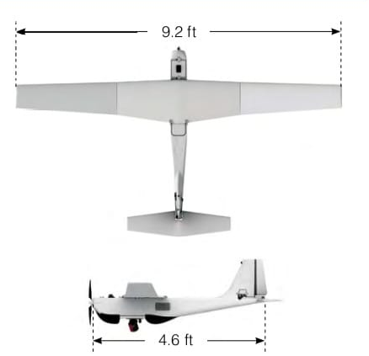
METHODOLOGY
Data collection
Design selection
Component used
Data analysis
specification of prototype prototype
Specification | value
Wing span | 9.2 ft
Fuselage length | 4.6 ft
Altitude | 500 ft
endurance | 120 mins
Range | 20 km

Slide 8
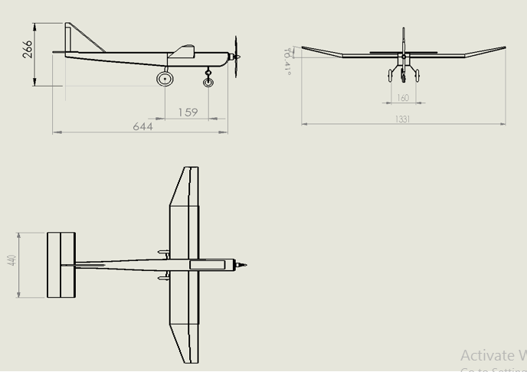
Specification | Values
Wing span | 1.3m
Fuselage length | 0.644m
propeller | 9 inches
Endurance | 15mins
Battery capacity | 1200mah
Payload | 200g
Range | 800m
No. of Engines | 1
current design specification table prototype 2D Design

Slide 9
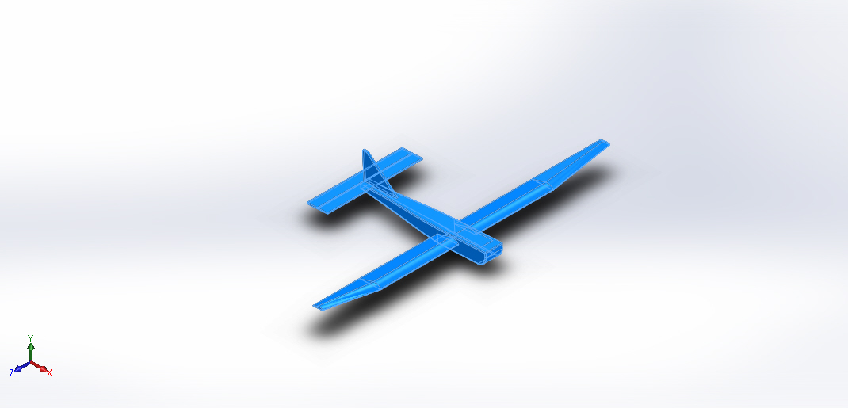
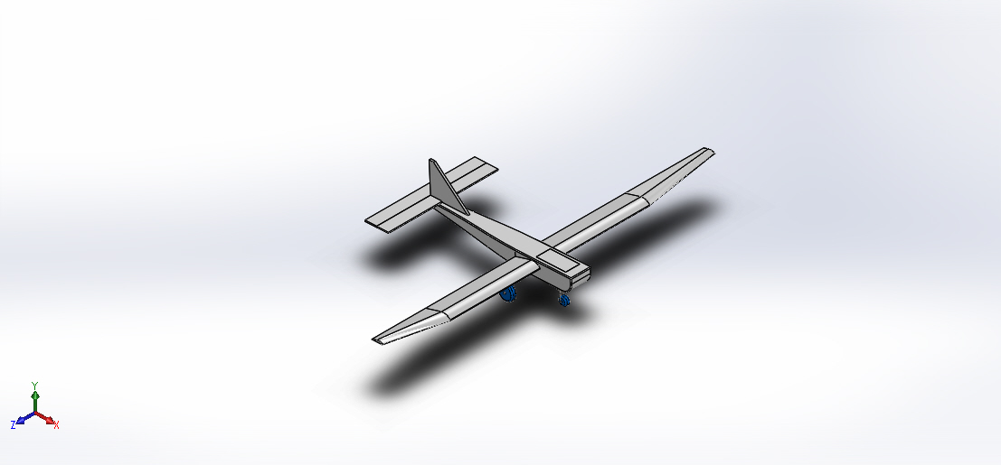
Figure A. 3-D model of the RQ-20 puma Figure B. 3-D model of the present study

Slide 10
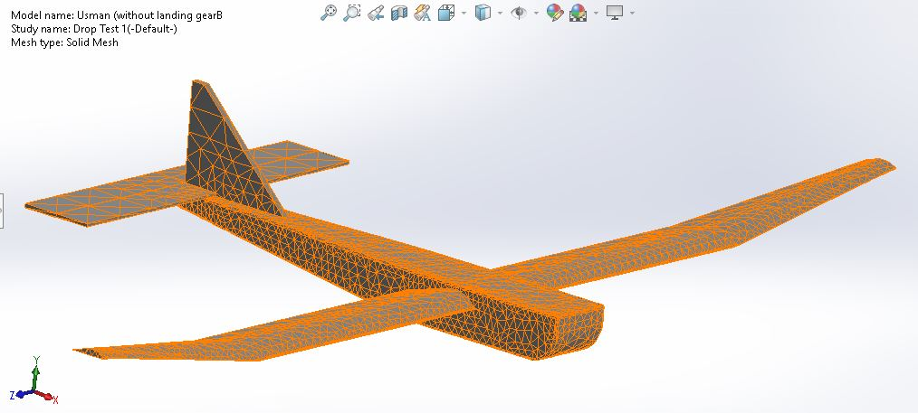
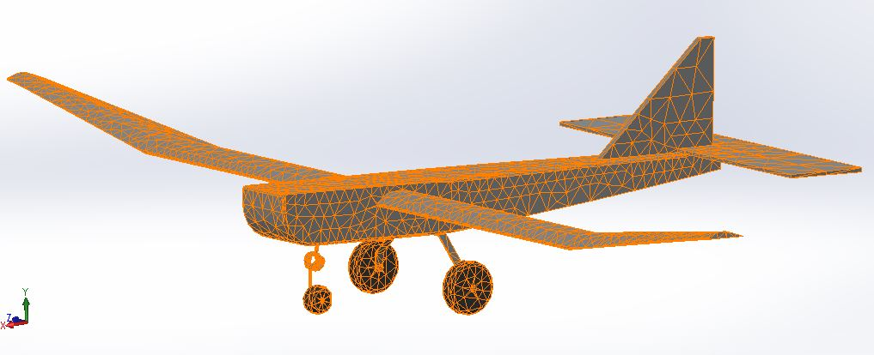
(a)RQ-20 puma Tetrahedral meshing (b)Tetrahedral meshing of the present study

Slide 11
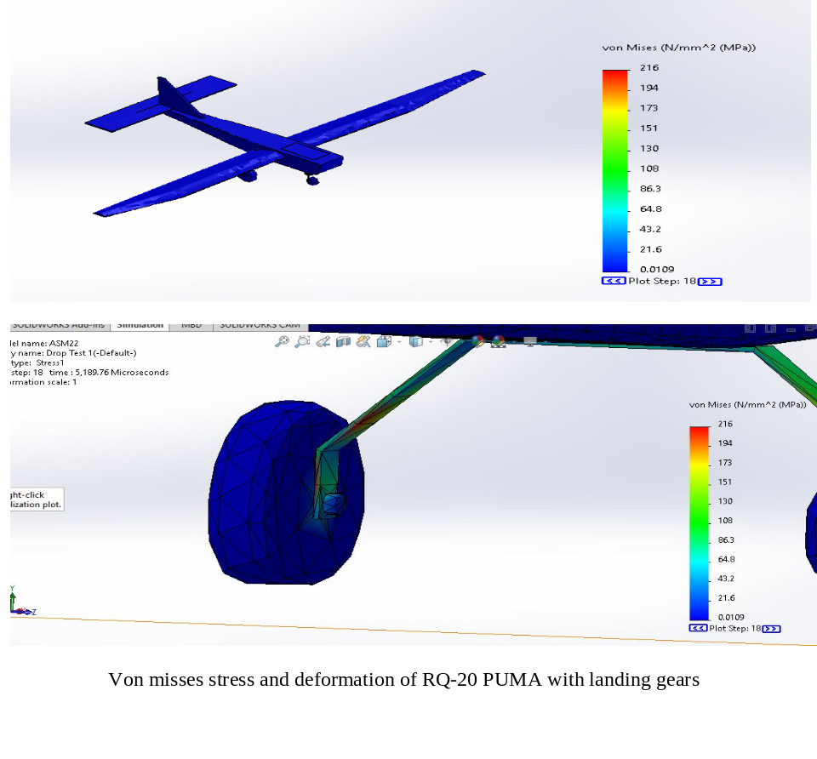
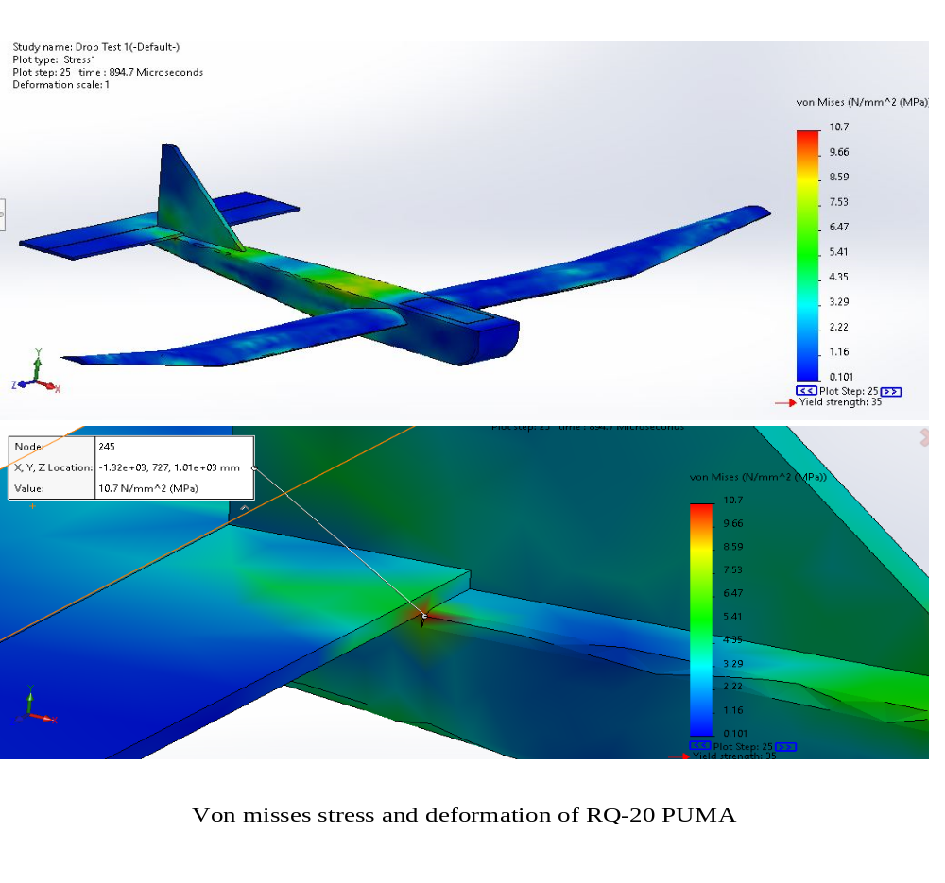
Figure A. Stress distribution on the present study
RESULTS AND DISCUSSIONS
Figure B. Stress distribution on RQ-20 Puma

Slide 12
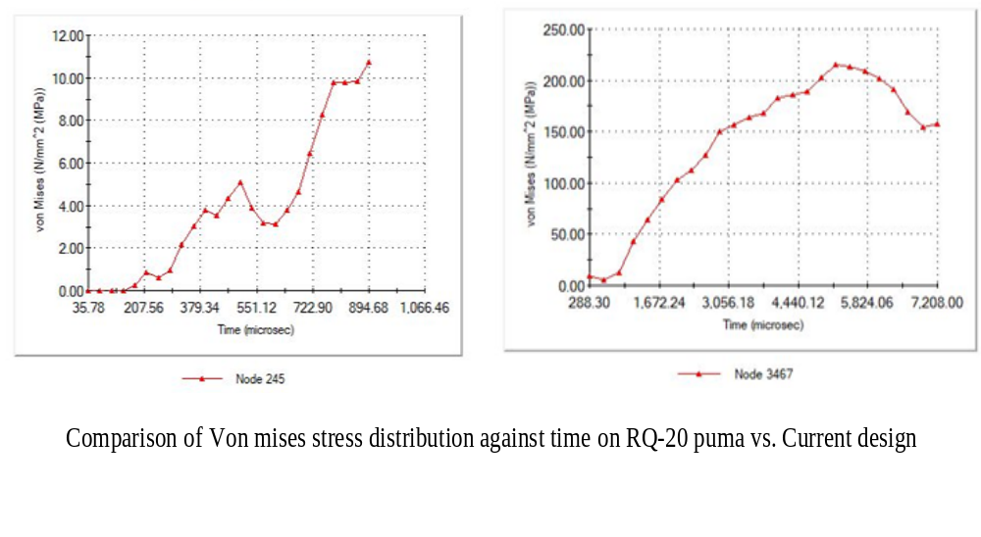
RESULT

Slide 13
CONCLUSION
The present study has the maximum stress impact at the landing gear strut during landing, and it has minimum impact at the fuselage. Comparatively, RQ-20 puma UAV has the maximum stress impact at the rear section of the fuselage.

Slide 14
RECOMMENDATION
Based on the research, it is recommended that the UAV should be designed to have a landing gear in other to prevent it from belly landing and protect it's fuselage from substantial damage during landing.

Slide 15
REFERENCES
Abramowitz A, Smith TG, Vu T. (2009)Vertical drop test of a Shorts 330 airplane. National Technical Information Service (NTIS).
Andrew J. Keane, Andras Sobester, James P. Scanlan (2017) Small Unmanned Fixed-Wing Aircraft Design. A Practical Approach, Wiley
Anderson, J.D., Jr.,(1999) Aircraft Performance and Design; McGraw–Hill: New York, NY, USA.
Bakker. A, (2015) Applied Computational Fluid Dynamics: Meshing.
Mohammad, H.S.(2013) Aircraft Design: A Systems Engineering Approach; John Wiley & Sons Ltd.: West Sussex, UK.
Reg Austin (2010), “Unmanned Aircraft Systems UAV design, development and deployment”, Wiley publishers.

Slide 16
Thank you

